Slide 1


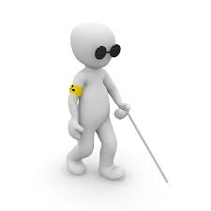

SRI RAMAKRISHNA ENGINEERING COLLEGE
[Educational Service : SNR Sons Charitable Trust]
[Autonomous Institution, Accredited by NAAC with ‘A’ Grade]
[Approved by AICTE and Permanently Affiliated to Anna University, Chennai]
[ISO 9001-2008 Certified and all eligible programs Accredited by NBA]
VATTAMALAIPALAYAM, N.G.G.O. COLONY POST, COIMBATORE – 641 022.
DEPARTMENT OF ELECTRICAL AND ELECTRONICS ENGINEERING
SMART GUIDE
Batch Members:
RANJIT. V.S.
SRINATH. D
03/03/2018
01

Slide 2
Abstract
A person with blindness can easily detect obstacles on ground, surface textures, pot holes etcetera while travelling with a Smart Guide. At times using a smart guide could result in scratching a parked vehicle with a Smart Guide, bumping into another person, excetra. A Smart Guide solves the above challenges and empowers visually impaired through independent and safe mobility.
03/03/2018
02

Slide 3
Senses
 | WORLD | INDIA
BLIND | 39 Million | 15 Million
LOW VISSION | 246 Million | 37.5 Million
03/03/2018
03

Slide 4

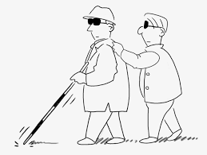
Existing Systems
Guide Dog
Walking Stick
03/03/2018
04

Slide 5
Block diagram
Power Supply
Ultrasonic Sensor
Microcontroller
Buzzer
03/03/2018
05

Slide 6
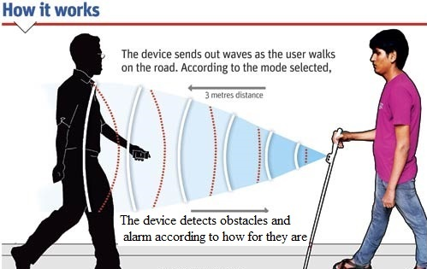
Working
03/03/2018
06

Slide 7
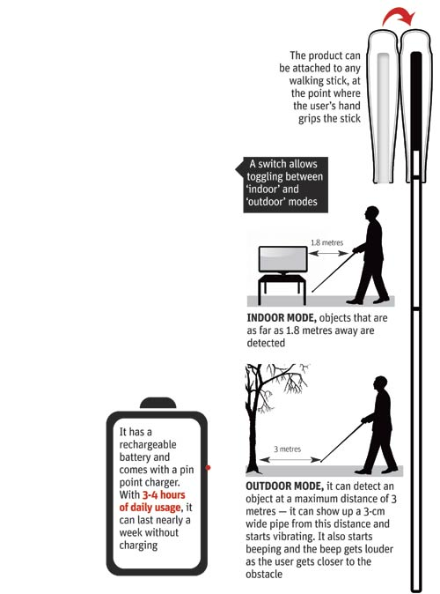
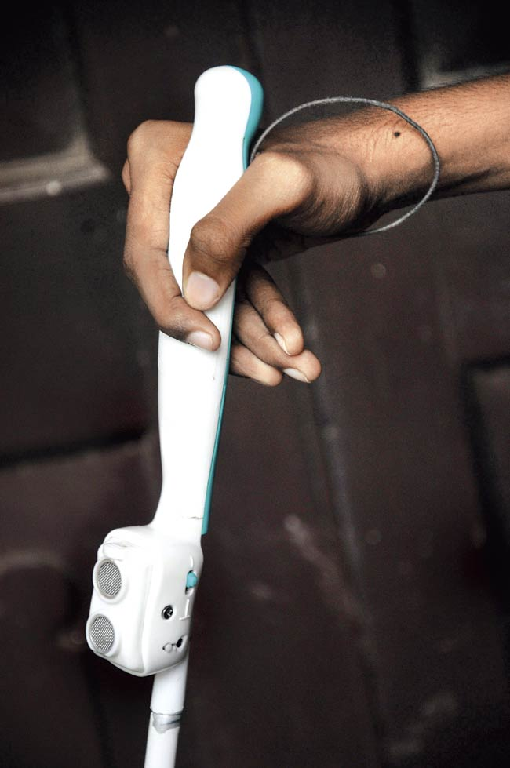
03/03/2018
07

Slide 8
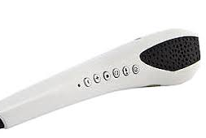
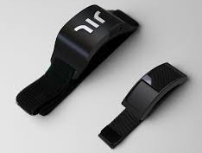
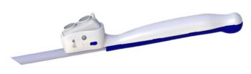
Proposed Systems
Smart Guide Wearable Device
Smart Guide in Walking Stick
Smart Guide as Carrying Device
03/03/2018
08

Slide 9
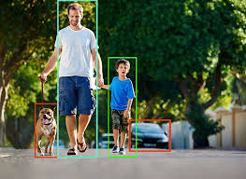
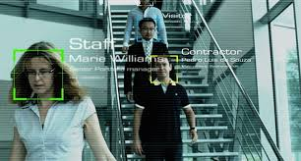
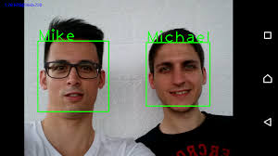
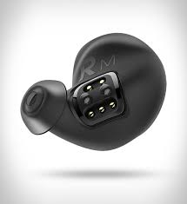
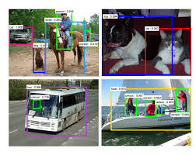
Future Extension
03/03/2018
Wireless Ear Phone
09

Slide 10
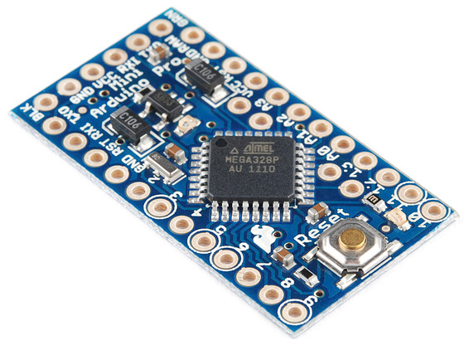
Components required
Arduino Mini Pro
The Arduino Mini Pro is a small, complete, and breadboard-friendly board based on the ATmega328P. It has more or less the same functionality of the Arduino UNO. It lacks only a DC power jack, and a Mini-B USB cable.
03/03/2018
10

Slide 11
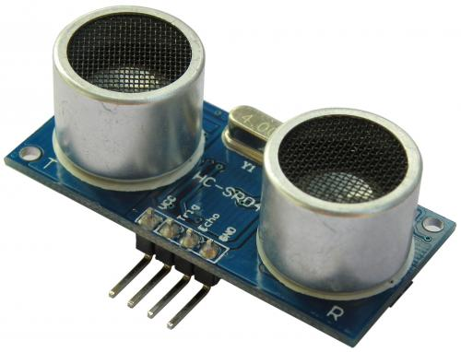
Ultrasonic Sensor HC-SR04
HC-SR04 is an ultrasonic ranging module that provides 2 cm to 400 cm non-contact measurement function. The ranging accuracy can reach to 3mm and effectual angle is < 15°.It can be powered from a 5V power supply.
03/03/2018
11

Slide 12
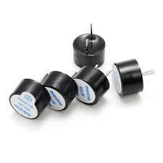
5v Buzzer Module
On-board passive buzzer
On-board 8550 triode drive
It can be controlled with single-chip microcontroller IO directly
Working voltage: 5V
Board size: 22 (mm) x12 (mm)
03/03/2018
12

Slide 13
Advantages
This can help visually impact to guide their ways easily.
This could help to avoids the accidents faced by the visually impacts.
Smart Guide is a cheaper compared to other devices, so it can be easily purchased by a poor people.
03/03/2018
13

Slide 14
LIMITATION
Smart Guide cannot detect overhanging objects like tree branches, sign boards, open glass windows, etcetetra.
Smart Guide can not be used in moisture atmosphere.
Regular charging is required to activate the device.
03/03/2018
14

Slide 15
Budget Estimation
S.NO | List of components | Price (in INR)
1 | Arduino Nano | 300
2 | Ultrasonic Sensor HC-SR04 | 250
3 | 5v Buzzer Module | 160
4 | Connecting wires | 60
5 | Battery | 500
6 | Outer insulation cover | 30
 |  | TOTAL: 1300
03/03/2018
15

Slide 16
Reference
A. M. Gibb, New media art, design, and the Arduino microcontroller: A malleable tool. PhD thesis, Pratt Institute, 2010.
D. Mellis, M. Banzi, D. Cuartielles, and T. Igoe, "Arduino: An open electronic prototyping platform, " in Proc. CHI, vol. 2007.
P. D. Minns, C Programming For the PC the MAC and the Arduino Microcontroller System. Author House, 2013.
03/03/2018
16

Slide 17
Thank you
03/03/2018
17

